Slide 1

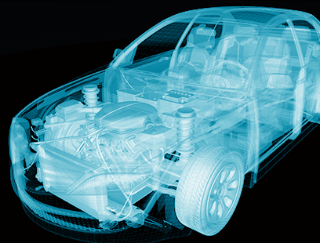



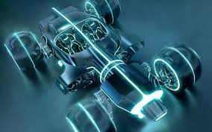
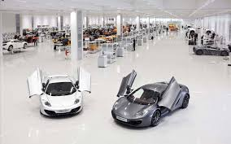
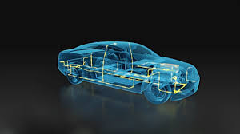
Car Parts Damage Detection Using Detectron2
Date: 05-July-2021

Slide 2
Car Parts Damage Detection using Detectron2
In this project we detect the damaged car parts using Detectron2 computer vision type algorithm
There are five categories of parts damaged: headlamp, front_bumper, hood, door, rear_bumper
The dataset consists of car images with one or more damaged parts
The img/ directory has 80 images
There are three more directories train/,val/, test/ for training, validation and testing purposes respectively
train/ directory contains 59 images, val/ directory contains 11 images, test/ directory contains 8 images
The files used for training the dataset are
COCO_train_annos.json: It is the training annotation file for detecting only one damage and only one category
COCO_mul_train_annos.json: It is the training annotation file for detecting parts that have multiple damages

Slide 3
The files used for validating the dataset are
COCO_val_annos.json: It is the validation annotation file where only one damage and only category is present
COCO_mul_val_annos.json: It is the validation annotation file where multiple damages are present
Pre-requisites:
Google Colab, Detectron2, PyTorch =1.7.0, TorchVision = 0.8.1
Clone the github repository git+https://github.com/cocodataset/cocoapi.git#subdirectory=PythonAPI inside the local system

Slide 4
Detectron2
PyTorch based modular object detection library
Open-source detection system from Facebook AI Research
Used to train various models like Densepose and panoptic feature pyramid network for detection tasks like bounding box, person keypoint detection, semantic segmentation and instance segmentation
Flexible, extensible and able to provide the fast training on single or multiple GPU Servers
Used as a library to support building research projects on top of it
Trains much faster

Slide 5
Steps for Car Parts Damage Detection
Import the required libraries for visualization
Download the Github repository of COCO API
Define the dataset directories for validation images
Initialize COCO API for instance annotations
Display the categories and super categories of car parts
Find all the images containing ‘damage’ categories and randomly select one category
Receive the damage annotations for a particular image and plot using libraries in the form of bounding box
Repeat this procedure for multiple damaged parts annotation

Slide 6
Steps for Car Parts Damage Detection Contd….
Train the object detection model using detectron2
Loading the car dataset for training and validation directories
Running COCO instance segmentation algorithm on a MaskCNN
Evaluate the model with respect to parameters like class accuracy, total loss, bounding box average precision, segmentation average precision

Slide 7
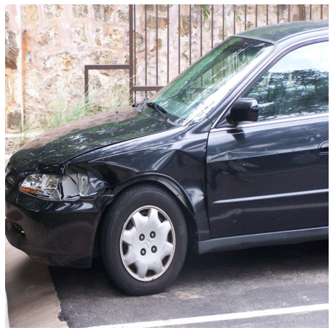
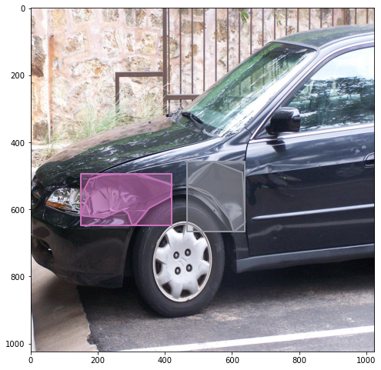
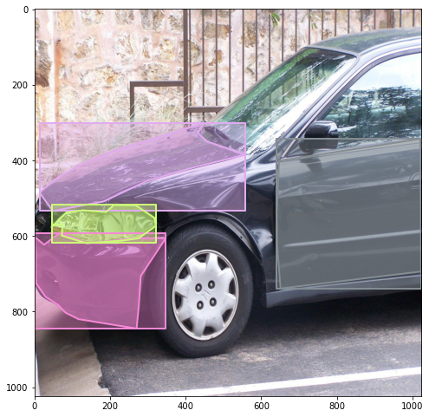
Results of Damaged Car Parts Detection

Slide 8
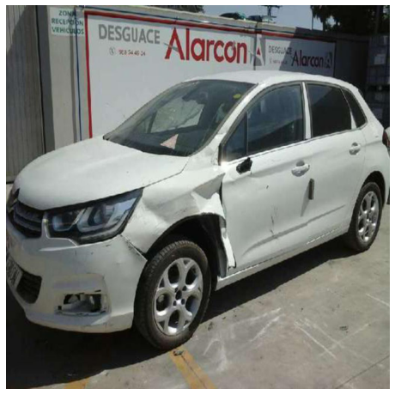
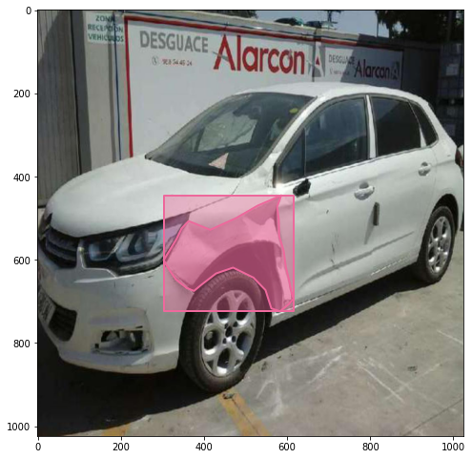
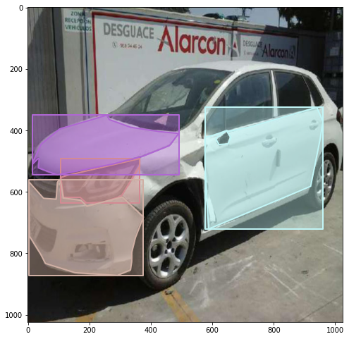

Slide 9
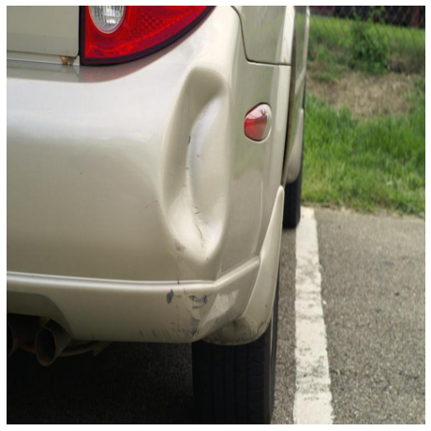
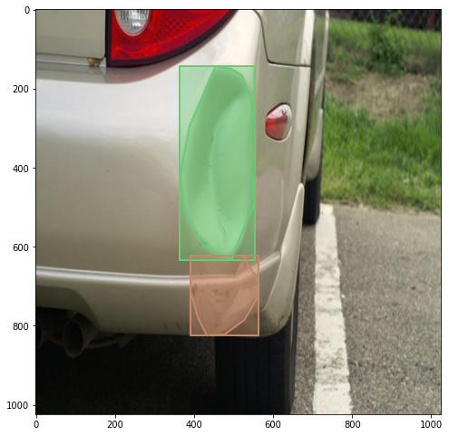
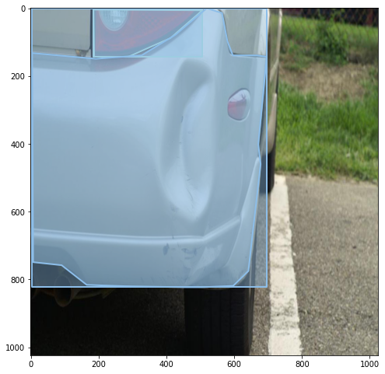

Slide 10
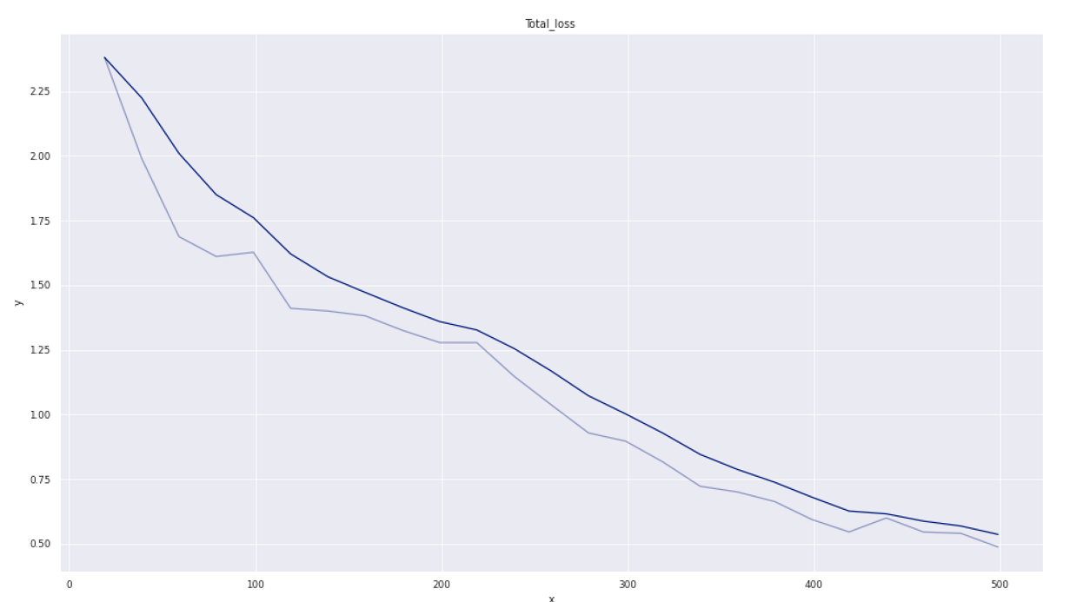
Evaluation of Model Metrics
Total Loss

Slide 11
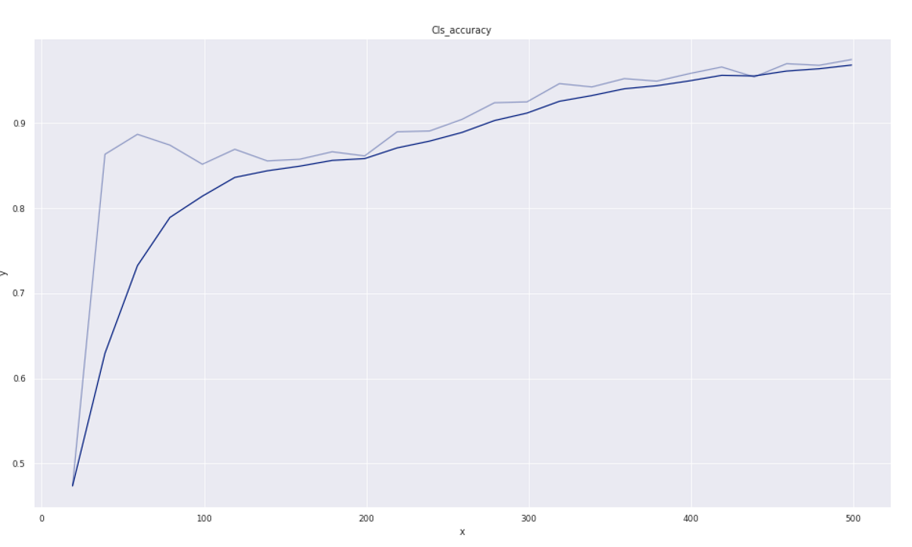
Class Accuracy

Slide 12
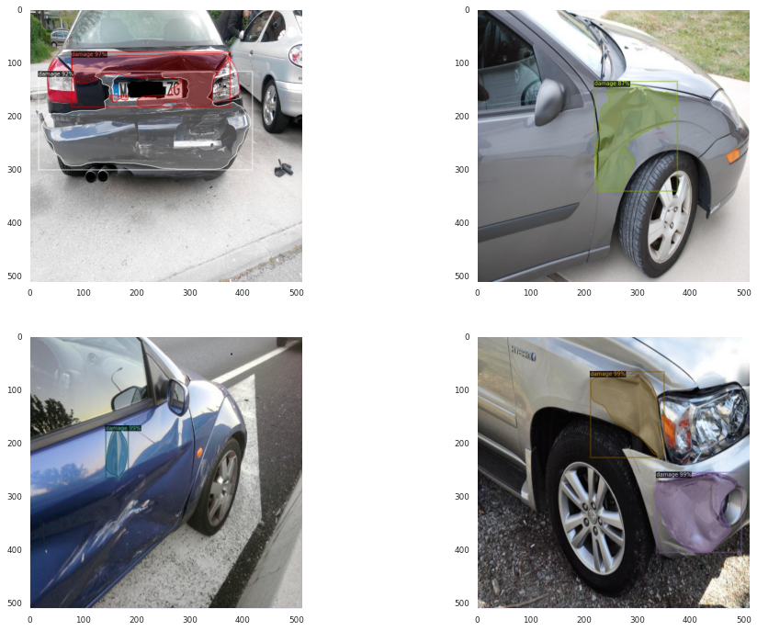
Results of Damaged Car Parts Detection in terms of %

Slide 13
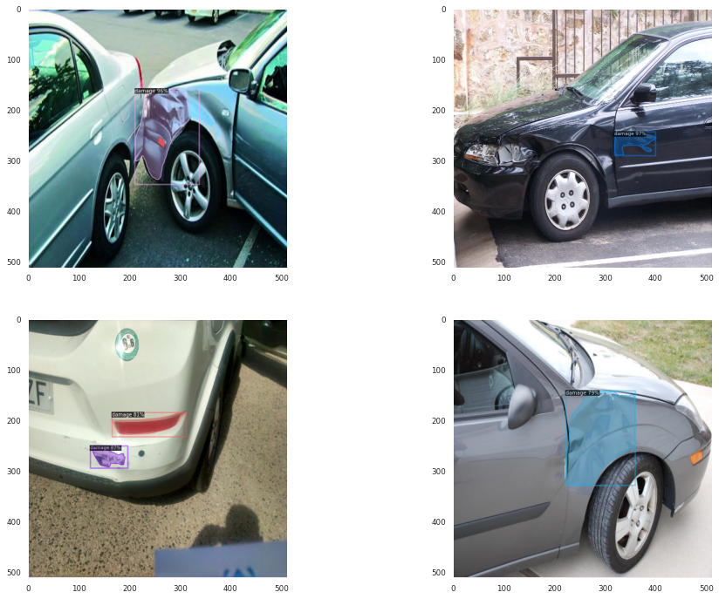

Slide 14
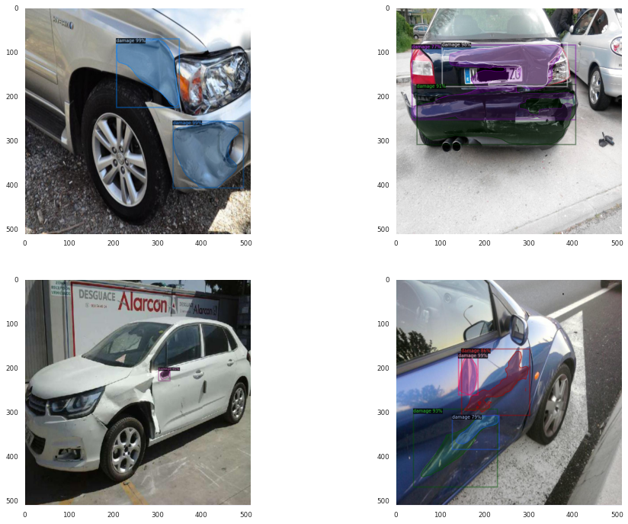

Slide 15
References
https://www.kaggle.com/lplenka/coco-car-damage-detection-dataset
https://github.com/facebookresearch/detectron2
https://github.com/neokt/car-damage-detective
https://faculty.utrgv.edu/dongchul.kim/csci4352/spring2019/report/R11.pdf

Slide 16

Address:
TPRI Technologies India Pvt Ltd,
9th Floor, Trifecta Adatto, ITPL Main Road,
Mahadevapura, Bengaluru, Karnataka, 560048
India | www.technopro.com/en
16

Slide 17
17

